Slide 1

CSE 8A – Introduction to Programming and Computational Problem Solving I
LLM WorkFlow and Common Python Operations
How to get help:
Class Website
https://sites.google.com/ucsd.edu/cse8afa23/home
Piazza for brief questions or logistic questions
Tutor Hours for help with homework/setting up computer
Office Hours for homework/conceptual help
Slides based, in part, on materials from Dan Zingaro.
Notes:
Welcome!

Slide 2
Three (or four?) tasks of a new programmer
Code Tracing
E.g., What is the value of variable n on line 4?
Code Explaining
E.g., that block of code finds the area of a triangle
E.g., that function should be named area_triangle
Code Writing
E.g., create a function that finds the area of a triangle
+Code modification
E.g., given this code, change it so it has a new behavior
Venables et al. A closer look at tracing, explaining and code writing skills in the novice programmer. ICER 2009.

Slide 3
Announcements
Students adding late (deadline moved for everyone):
HW0 (on canvas) extended until Friday
Reading Quiz 1 and 2 extended until Friday
Lab yesterday
Grading will be kind (bunch of issues with the system)
Must arrive on time to do the lab
we’ll offer a small cushion but will turn students away if past that time
Homework 1 due on Monday at 10pm
Reading for next week due on Tuesday at noon
Notes:
Mention extension

Slide 4
Learning Goals for Today
By the end of today’s lecture, you should be able to:
Use the LLM workflow for designing a function for simple functions
Recognize and use standard programming operators
Draw memory models for basic programs

Slide 5
Choosing Parameters
How do you decide on the parameters of a function?
Ask the question:
“What does the function need to know to do its job?”
Style rule: Everything a function has to “know” should be provided as a parameter
Function can access:
Local variables (including parameters)
Global variables (often bad style)
Built-in functions/variables (e.g., abs)
But not parameters and variables of other functions!

Slide 6
Calling Functions
def a(num):
return val + num + 3
def b(val):
return a(1)
print(b(2))
What is the output of this code?
6
7
4
5
Error because of an undefined variable
Notes:
Draw memory models

Slide 7
Calling Functions
def a(num, val):
return val + num + 3
def b(val):
return a(1, 1)
print(b(2))
What is the output of this code?
6
7
4
5
Error because of an undefined variable
Notes:
Call out that a(1,1) is bad form because it doesn’t use the parameter val!
Draw memory models

Slide 8
Returning from a function
def first(val):
return val
def second(val):
print(val)
Which of the functions returns val?
first
second
both
neither
Notes:
Just first! Addresses common misconception that confuses “printing” with “returning”

Slide 9
Return vs. print
We have said that return terminates the function and returns a value to its caller
If there is no return, the function returns the value None
We have also used the print function, which outputs its arguments to the screen
print takes arguments and prints them out with a space separating the values
print as a function itself actually returns None

Slide 10
Designing Functions with Copilot

Slide 11
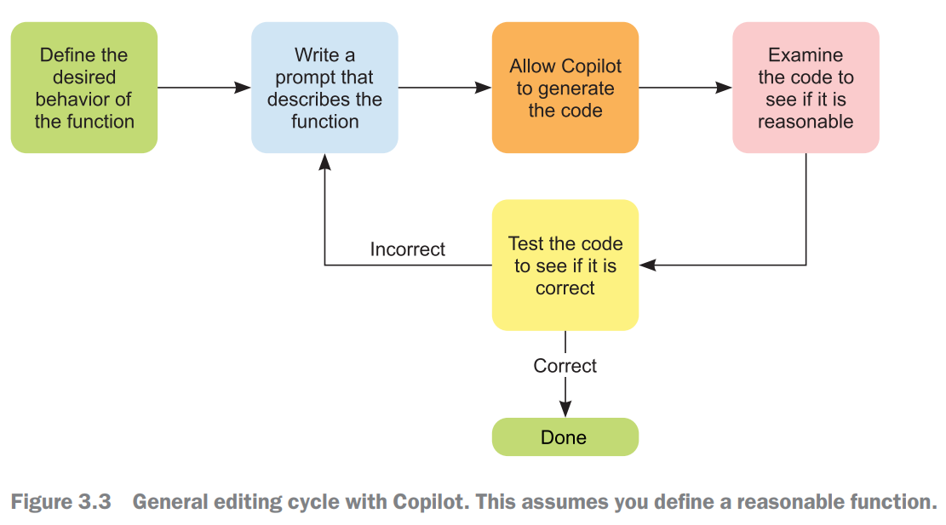
Overview of the Design Cycle
Notes:
Live code for a few more functions if time. Then take a close look at Area of a Circle

Slide 12
Step 1 – Write the function signature
Need to understand the behavior of the function – specifically, what are its inputs and output and what would be a good name for the function. Then write the function signature.
For example, to compute the area of a circle, you need to know it’s radius:
def area_circle(radius):

Slide 13
Step 2 – Describe the function in a docstring
Now you need to describe the desired behavior of the function in a docstring. The more complex the function, the larger the description
def area_circle(radius):
"""
Function takes radius as a parameter and
outputs the corresponding area of a
circle.
"""

Slide 14
Step 3 – Generate Code
Let Copilot generate code.
def area_circle(radius):
"""
Function takes radius as a parameter and
outputs the corresponding area of a
circle.
"""
return 3.14 * radius ** 2

Slide 15
Step 4 – Determining if the code is reasonable
Examine it to see if it is reasonable (you will get better at this as the quarter goes on).
def area_circle(radius):
"""
Function takes radius as a parameter and
outputs the corresponding area of a
circle.
"""
return 3.14 * radius ** 2

Slide 16
Overview of the Design Cycle
Based on the reading, what should you do if the code is NOT reasonable for what you wanted it to do?
Use <ctrl>+Enter and explore other suggestions
Try to write a new prompt to see if you get better suggestions
Try to edit the code yourself to make it work
Call a tutor for help

Slide 17
Step 5 - Testing
Test the code. Try basic/standard values but also try unexpected values (e.g., 0, negative numbers, etc.)
def area_circle(radius):
"""
Function takes radius as a parameter and
outputs the corresponding area of a
circle.
"""
return 3.14 * radius ** 2
print(area_circle(2))

Slide 18
Demo – Two ways to test
In the code itself or in the terminal.
When describing tests in Python, the standard format is to write a >>> before the command and the expected value on the next line. For example:
>>> area_circle(1)
3.14
We will use this format of “doctests” soon!

Slide 19
Testing functions
At an intergalactic pizzeria, Earthlings order two slices, Andalites order three slices, and Martians order one slice. Write a function that takes three parameters representing the number of Earthlings, Andalites, and Martians, and returns the required number of slices.
Which example is correct?
>>> num_slices(1, 2, 3)
6
>>> num_slices(1, 2, 3)
11
>>> num_slices(1, 2, 3)
13
>>> num_slices(1, 2, 3)
14
A.
B.
C.
D.
Notes:
2+(2*3)+(3*1)=11

Slide 20
Demo: Solving this function
At an intergalactic pizzeria, Earthlings order two slices, Andalites order three slices, and Martians order one slice. Write a function that takes three parameters representing the number of Earthlings, Andalites, and Martians, and returns the required number of slices.
Which example is correct?
>>> num_slices(1, 2, 3)
6
>>> num_slices(1, 2, 3)
11
>>> num_slices(1, 2, 3)
13
>>> num_slices(1, 2, 3)
14
A.
B.
C.
D.
Bonus – what if pizzas were 8 slices each and you had to return the number of pizzas rather than the number of slices? Hint: Use math.ceil.
Notes:
Code this with the students to show the need to test properly, etc.

Slide 21
Good function descriptions
In the description, you should describe precisely what the function does
Do not specify how the function does it
Make the purpose of every parameter clear
Refer to every parameter by name
Be clear about whether the function returns a value and, if it does, what it returns
Explain any condition that the function assumes are true (e.g., base and height are positive values)

Slide 22
Basic Operators in Python

Slide 23
Python as a calculator
Python supports many common mathematical operators
+ (addition)
Can do += as a shorthand when incrementing variables
For example, x += b is the same as x = x + b
However, be careful doing this with anything other than int and floats as behavior can vary in unexpected ways, enough so I recommend you not use +=
- (subtraction)
* (multiplication)
** (exponentiation)
/, // (two different division operators!)
% (remainder, AKA modulus, mod)
Notes:
Explain operators vs. operands
Demo concatenation and repetition of strings if time

Slide 24
Division and Mod
/ means perform standard division (result is a float)
// means perform integer division (result must be an int)
% operator returns the remainder
Notes:
Talk through each quickly.

Slide 25
Python as a calculator
PEMDAS is automatic order of operation
Parenthesis, Exponent, Multiply, Divide, Add, Subtract
Use parenthesis to change precedence
4 + 5 * 3 is different than (4 + 5) * 3

Slide 26
Division and mod
What is printed by the following (not well written) code?
a = 18
b = 9
c = 0.5
x = (a/b)//3 + a%8 + c
print(x)
A. 2.5
B. 2.75
C. 3.16666666666
D. 3.41666666666
E. None of the above
Notes:
2 // 3 + 18%8 + 0.5
0 + 2 + 0.5
2.5

Slide 27
Variables revisited – Code Explaining
What does this code do?
# assume a and b are already defined
temp = a
a = b
b = temp
Discuss in your groups. Goal is a single sentence that describes the effect of the code without giving a line-by-line explanation
Notes:
Explain in Plain English style question.

Slide 28
Summary
LLMs have a clear design flow when working with functions we’ll use all course
Python has numeric operators for calculations and string operations for text
We need a clear understanding of these to be able to read code
Notes:
Mention extension

